Slide 1
Abstract
Background
This project is part of the initiative to implement the International Patient Summary - IPS in Brazil, focusing on the allergy component. The IPS contains the essential health information necessary for the continuity of care nationally or abroad. In this work, the Brazilian Classification of Allergies and Adverse Reactions (CBARA) (1) concepts were mapped to the SNOMED-CT IPS Refset. The CBARA is based on the Portuguese Catalog of Allergies and Adverse Reactions (CPARA) established in Portuga(2). The section on allergies was mapped to the IPS terminology considering the ISO TR-12300:2014 Health Informatics — Principles of mapping between terminological systems, using its proposed cardinality and degree of equivalence of the mappings. All mappings were entered into an open-source terminology service and integrated into the FHIR terminology service. These mappings will be used to specify the Allergies section of IPS-Brasil.
The Brazilian MOH has decided as part of its national eHealth Strategy to develop the international Patient Summary starting with the sections on Immunization, Exams and Allergies and Adverse Reactions.
To start the development of the Allergies Section of the Brazilian IPS it was necessary to map the Brazilian Classification of Allergies and Adverse Reactions (CBARA) to SNOMED-IPS as preconizes the IPS FHIR Implementation Guide for the Allergy Intolerance section.
The Brazilian Catalog of Allergies and Adverse Reactions (CBARA) is an initiative of the Secretariat of Primary Health Care of the Ministry of Health of Brazil in cooperation with the Ministry of Health of Portugal through the Shared Services of the Ministry of Health that seeks to initiate a standardization process of clinical terms related to allergic conditions. Its elaboration was based on version 3.2 of the Portuguese Catalog of Allergies and Adverse Reactions (CPARA).

Slide 2
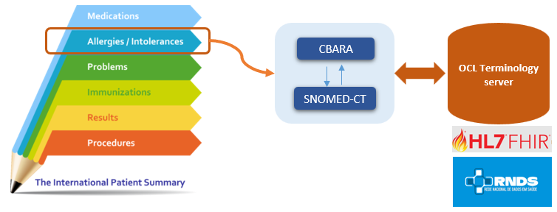
Approach
The mapping was carried out using spreadsheets and the Snap2Snomed tool [4]. Based on the set of terms defined for substances and allergens in the CBARA, the terminologists verified the corresponding terms in the IPS, also consulting them via the IPS browser. The complete list of CBARA terms and SNOMED IPS refSet have been added to the open source terminology server Open Concept Lab (OCL). The mapping tables described as concept maps were also added to the OCL terminology server .
To verify the degree of similarity of the terms, the concepts of the ISO 12300 standard and their respective levels of equivalence were considered, namely [5]:
(1) Equivalence of meaning, lexical and also conceptual;
(2) Equivalence of meaning, but with synonymy;
(3) The source concept is broader and has less specific meaning than the target concept/term;
(4) The source concept is narrower and has more specific meaning than the target concept/term;
(5) No mapping is possible. A concept with some degree of equivalence was not found in the target.

Slide 3
Results
CBARA has 152 terms to represent substances and allergens and these were the terms considered for mapping to SNOMED-IPS. Of these, 11 concepts (7.2%) were not found in the SNOMED IPS Refset, however, they were present in SNOMED-CT core as depicted in Table 1 below. The remaining 141 terms were easily mapped to SNOMED IPS refeset with map equivalence of 1, meaning that there was meaning, lexical and conceptual equivalence.
TABLE 1. SNOMED CT CORE CONCEPTS NOT PRESENT IN IPS BUT PRESENT ON SNOMED-CT
SNOMED-CT Core Concept ID | SNOMED-CT Core Concept | CBARA term (translated to English)
260174003 | Cod (organism) | Cod
14241002 | Cockroach (organism) | Cockroach
15838006 | Snail (organism) | Snail
88818001 | Rabitt (organism) | Rabbit
421133009 | Subphylum Crustacea (organism) | Crustacea
422304003 | Family Poaceae (organism) | Family Poaceae
227430006 | Lime - fruit (substance) | Lime
77188000 | Mussel (organism) | Mussel
74964007 | Other | Other
90580008 | Fish (organism) | Fish
38946001 | Cuttlefish (organism) | Cuttlefish

Slide 4
Future Directions
Our work aims to initiate a use case of the allergy and adverse reactions component, by mapping the terms of the Brazilian CBARA classification, to collaborate to develop interoperability in the country.
The idea is that the applications that use our terminological resources can interoperate and use the semantic potential that is integrated into the concepts. Furthermore, we hope that the terms not yet included in the IPS, and flagged in this work, can be reviewed, and considered by the SNOMED organization and added to the IPS, so that our classifications are in perfect compliance with the terminology standards.
It is important to emphasize that besides Brazil, Portugal also uses the same classification to register allergies and adverse reactions.
Therefore, the need to include these 11 additional concepts in the IPS refset becomes even more necessary.

